Slide 1
UU World Gets social
Know and Grow your audience
Know and Grow your audience
EMBRACE AND SHARE YOUR MESSAGE
EMBRACE AND SHARE YOUR MESSAGE

Slide 2
Share what matters
Everything we say and do is social

Slide 3
For members only?

Slide 4
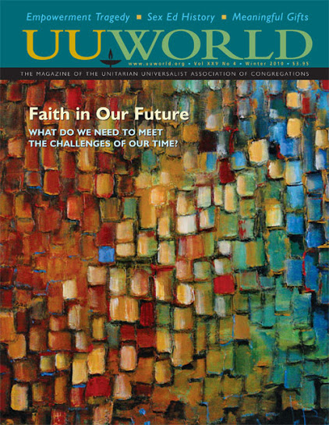
Members matter
The UUA publishes a magazine as a membership benefit.
126,000 households
Generous givers
Already engaged
Current, former, future leaders

Slide 5
Members reach out
They share what they value.
Give a copy to a friend
Buy a gift subscription
Share clippings
Leave in public places
They’re inspired by what they receive.

Slide 6
But members are already members
The problem

Slide 7
The message is worth sharing
The good news

Slide 8
UU World’s audience
According to our 2013 readership survey:
Almost half of UUA members are over 65
Almost three-quarters are women
63% have a graduate or a professional degree
43% are retired
Average reported household income is $98,500
Learn more: “Meet Our Readers,” uuworld.org/currentissue.html

Slide 9
UU World’s audience
More from our 2013 readership survey:
Two-thirds have served as a leader in their congregation
And almost all gave to their congregation last year
But only one in four has attended General Assembly
86% have never or rarely visited UUA.org
Learn more: “Meet Our Readers,” uuworld.org/currentissue.html

Slide 10
The message is worth sharing
The good news

Slide 11
Social media, old school
We launched uuworld.org, with almost everything from the print magazine, plus greatly expanded news coverage, a weekly email newsletter, and RSS, way back . . .
in 2005!

Slide 12
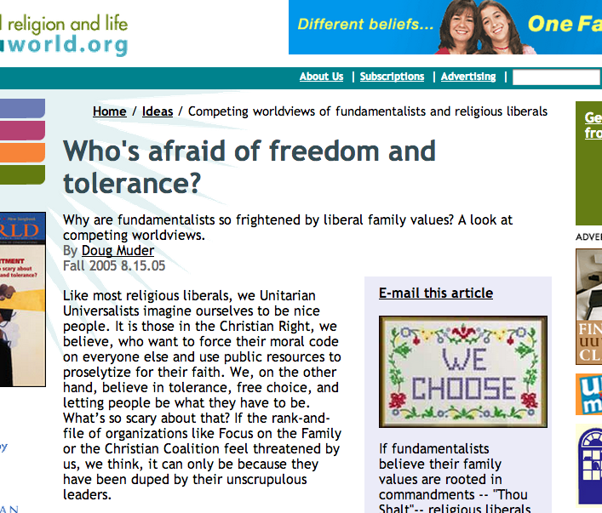
For more than members
Search engines bring people to the message
Online readers have even more ways to share

Slide 13
More ways to share
Printer friendly
te!! A Friend
Comments
None of this is cutting edge any more.

Slide 14
Sharing is the point
The point is

Slide 15
UU World on Facebook

Slide 16
Uu world on twitter

Slide 17
Uu world on flickr

Slide 18
Uu world on tumblr

Slide 19
The message is worth sharing
The point is

Slide 20
UU World, tablet ready

Slide 21
Sharing is the point
UU World has content a message you can share:
On your congregation’s social media channels
In your religious education programs for all ages
In your own life
Your congregation has content a message to share:
What inspires you in worship
What motivates you to acts of service
What needs you mobilize to meet

Slide 22
our message is worth sharing
For Members and beyond

