Slide 1
Welcome to Good News! Sharing Your UU Faith through Storytelling
Gail Forsyth-Vail, UUA Adult Programs Director
Rev. Kristin Maier, Skinner House Author
Rev. Erik Resley, Lead Organizer, the Sanctuaries
Jessica York, UUA Faith Development Director

Slide 2
In this workshop, you will
Learn how and why personal stories are an exceptionally good way to tell people about Unitarian Universalism
Reflect on your own UU stories
Try on what it will feel like to share those stories with others in real life

Slide 3
Think about your shimmering moment...
Where were you?
What happened?
How were you changed?

Slide 4
Write ONE WORD about your experience...
and
Another Word...
and Another Word...

Slide 5
Story and the Human Brain

Slide 6
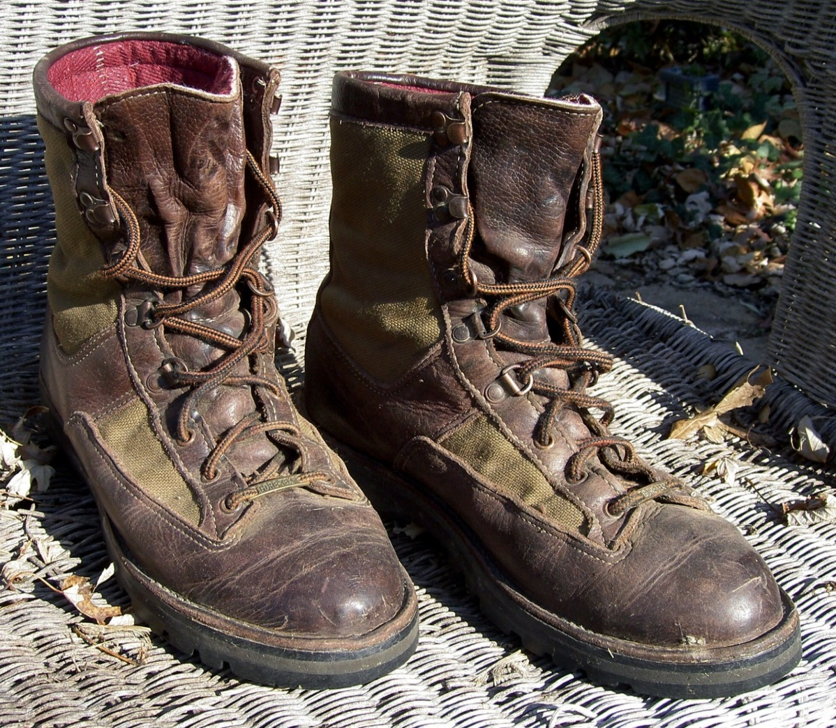
Story and the Human Spirit

Slide 9
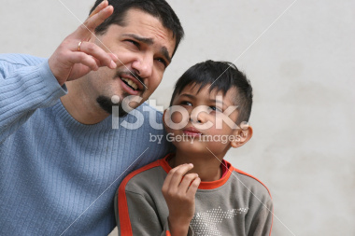
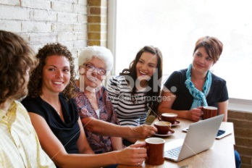
Your shimmering moment
Your powerful story

Slide 10
With a partner...
One person tells their story. (5 min.)
The other person responds. (2 min.)
What did you find moving or compelling in the story?
What did you appreciate about the story?
3. Switch roles.

Slide 11
Taking your story out into the world.

Slide 12
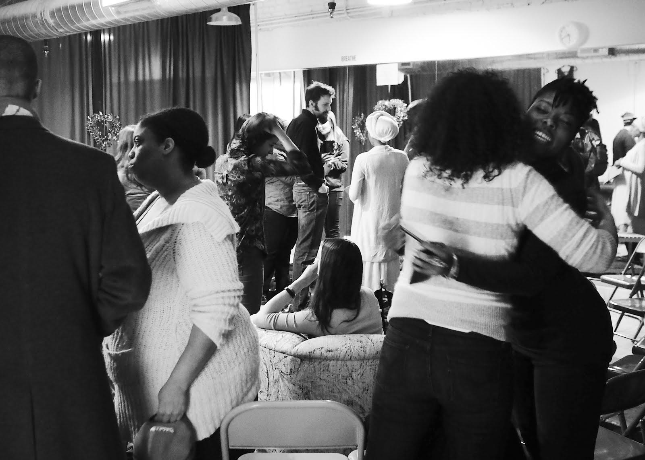
Why it really matters.

Slide 13
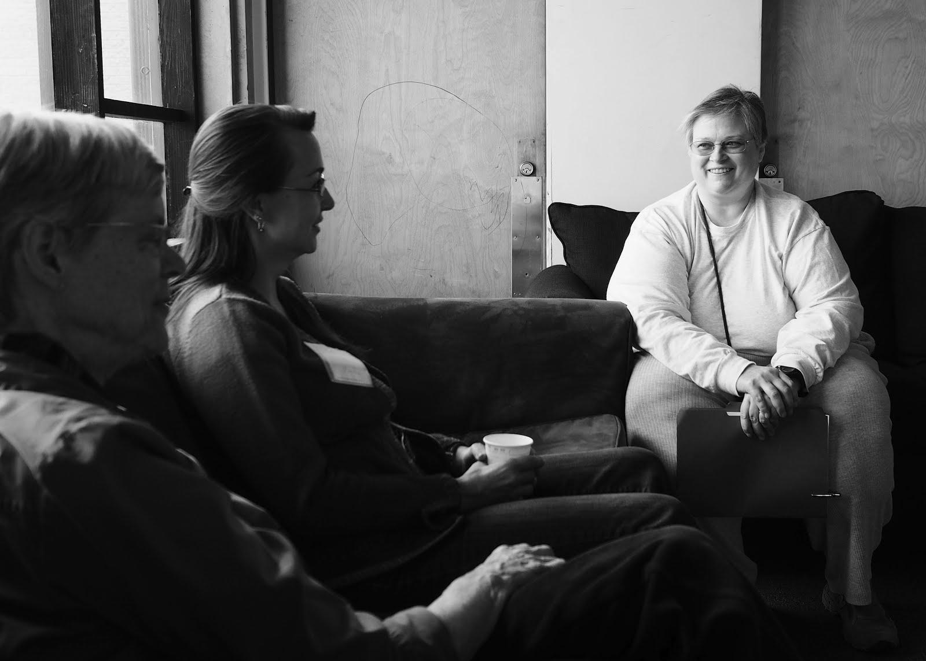
How to do it well.

Slide 14
How to do it well. Invite stories.

Slide 15
How to do it well. Honor experience.

Slide 16
How to do it well. Celebrate connection.

Slide 17
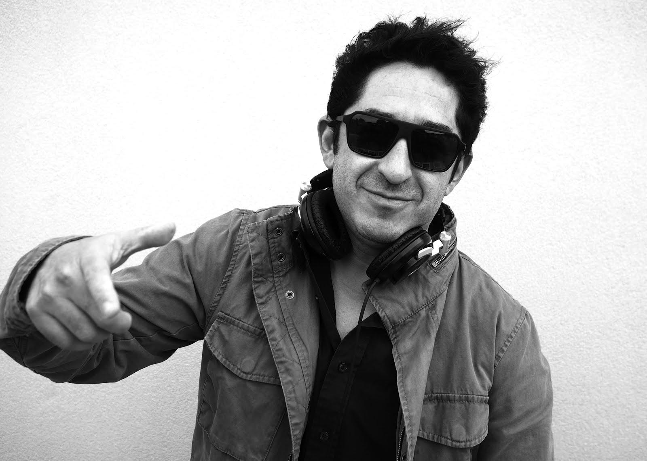
Activity: So, what is Unitarian Universalism?

Slide 18
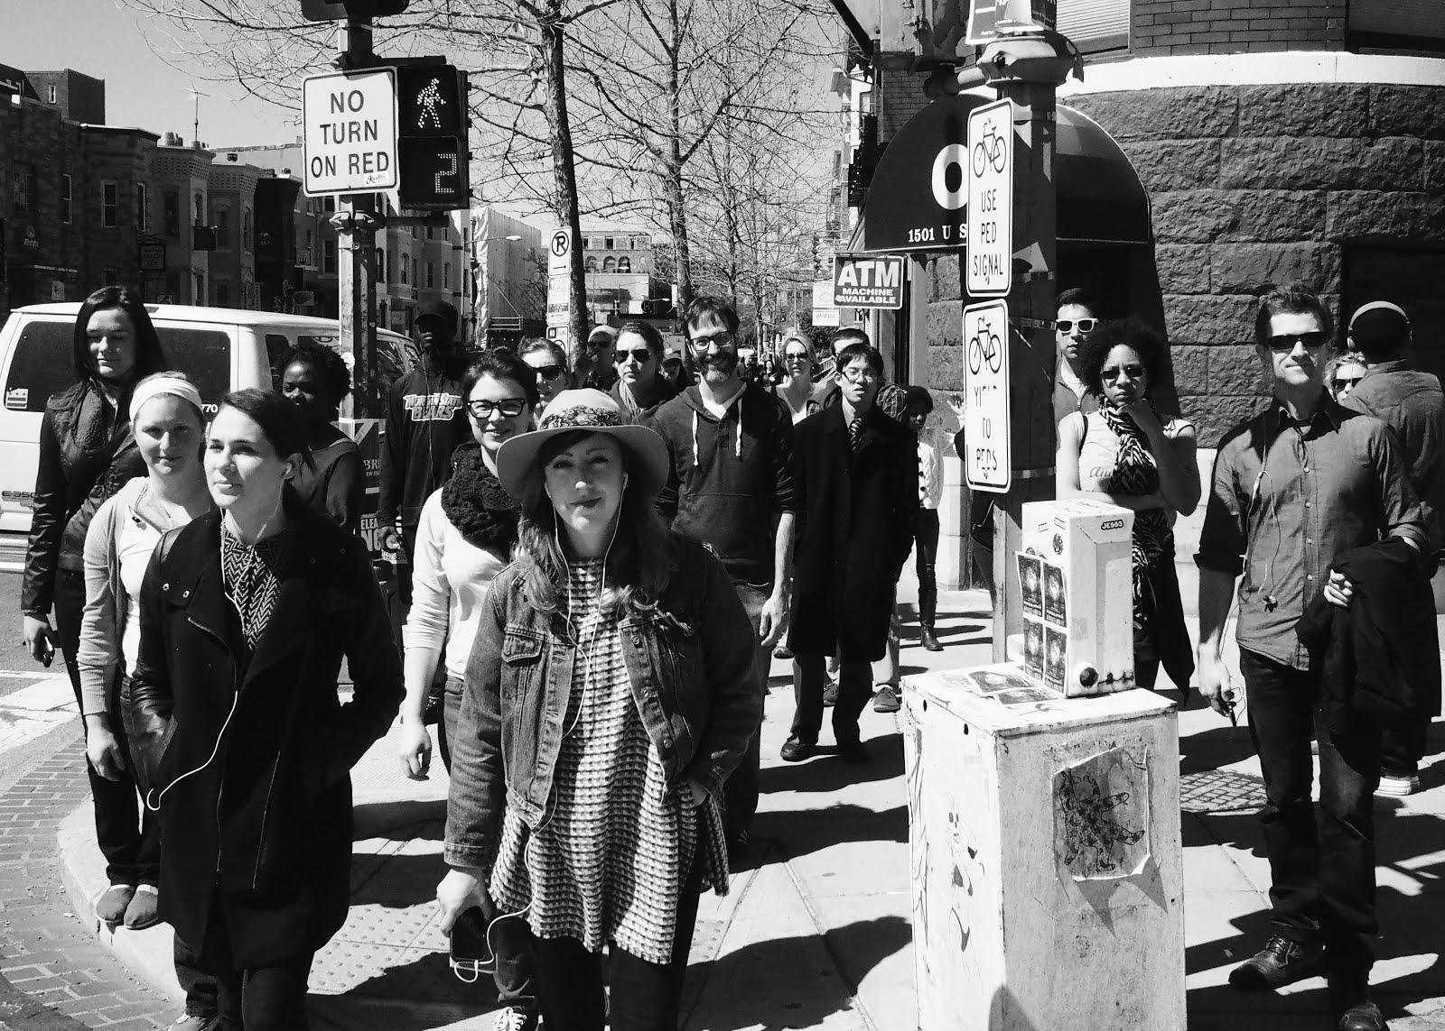
Go out and share stories! You can do it.

Slide 19
Do we want a closing slide?
What shoud it say?
WaterFire?
story buttons
other follow up (resources handouts?)

