Slide 1
Beyond Partisan Division – Reaching Out and In
Presenters:
Rev. Anya Sammler-Michael, Minister, Unitarian Universalist Congregation of Sterling
Rev Scott Sammler-Michael, Minister Accotink UUs
Rev Nancy McDonald Ladd, Minister River Road Unitarian Universalist Congregation
Paul Roche, Unitarian Universalist Congregation of Sterling
Friday June 27 2014
10:15 am – 11:30 am
Omni Narragansett C

Slide 2
Talking about politics makes me uneasy.

Slide 3
Talking about politics makes me uneasy.
I am concerned that this workshop is going to turn ugly.

Slide 4
Talking about politics makes me uneasy.
I am concerned that this workshop is going to turn ugly.
Oh shoot, I’m in the wrong room!

Slide 5
Talking about politics makes me uneasy.
I am concerned that this workshop is going to turn ugly.
Oh shoot, I’m in the wrong room!
I’ve had seven cups of coffee and I am still tired!

Slide 6
Talking about politics makes me uneasy.
I am concerned that this workshop is going to turn ugly.
Oh shoot, I’m in the wrong room!
I’ve had seven cups of coffee and I am still tired!
I really struggle to talk with people who belong to a different political party than mine.

Slide 7
Talking about politics makes me uneasy.
I am concerned that this workshop is going to turn ugly.
Oh shoot, I’m in the wrong room!
I’ve had seven cups of coffee and I am still tired!
I really struggle to talk with people who belong to a different political party than mine.
If my congregation became a place where people across the political spectrum were welcome, I would no longer feel welcome.

Slide 8
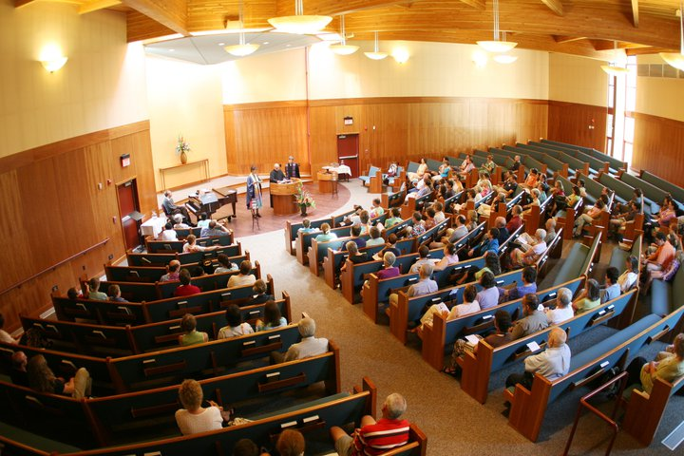
Unitarian Universalist Society of New Haven, CT

Slide 9
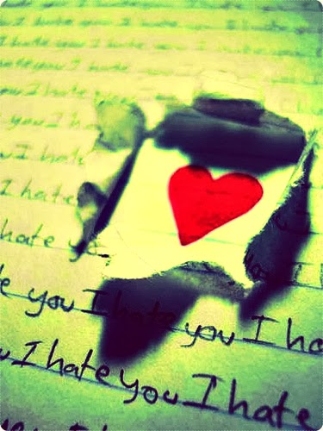

Slide 10
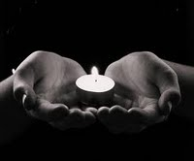
Covenant

Slide 11
Covenant
Be quick to hear and slow to speak
Respect the privacy of those who confide
Speak your truth in love
Absolutely no analogies that rely on Nazis, Fascists, or Stalinist Russia! :)
Call others, and be willing to be called, back into covenant.

Slide 12
Love Reaches Out and In - Beyond Partisan Division
https://www.facebook.com/groups/BeyondPartisanDivision/

Slide 13
“Two Monologues from Anonymous Unitarian Universalists.”
With Gratitude to our Actors:
Rev. David Keys
Rev. Lynn Strauss

Slide 14
#576 A Litany of Restoration
by Marjorie Bowens-Wheatley
If, recognizing the interdependence of all life, we strive to build community, the strength we gather will be our salvation. If you are black and I am white,
It will not matter.
If you are female and I am male,
It will not matter.
If you are older and I am younger,
It will not matter.
If you are progressive and I am conservative,
It will not matter.
If you are straight and I am gay,
It will not matter.
If you are Christian and I am Jewish,
It will not matter.
If we join spirits as brothers and sisters, the pain of our aloneness will be lessened, and that does matter.
(Together) In this spirit, we build community
And move toward restoration.

Slide 15
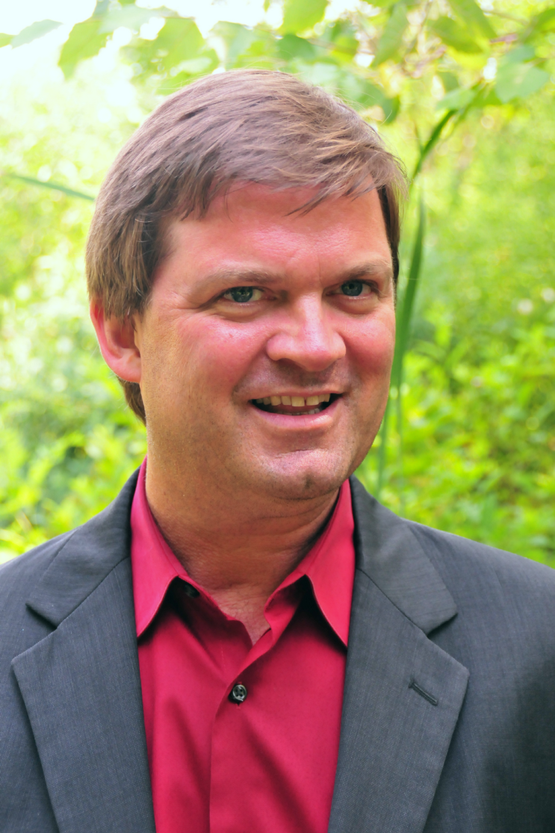
Rev Scott Reflection info

Slide 16
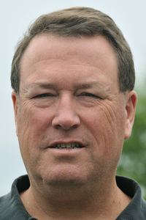
“How Being Intentionally Welcoming to non-Liberals Can Save Unitarian Universalism”
Paul Roche
Unitarian Universalist Congregation of Sterling VA

Slide 17
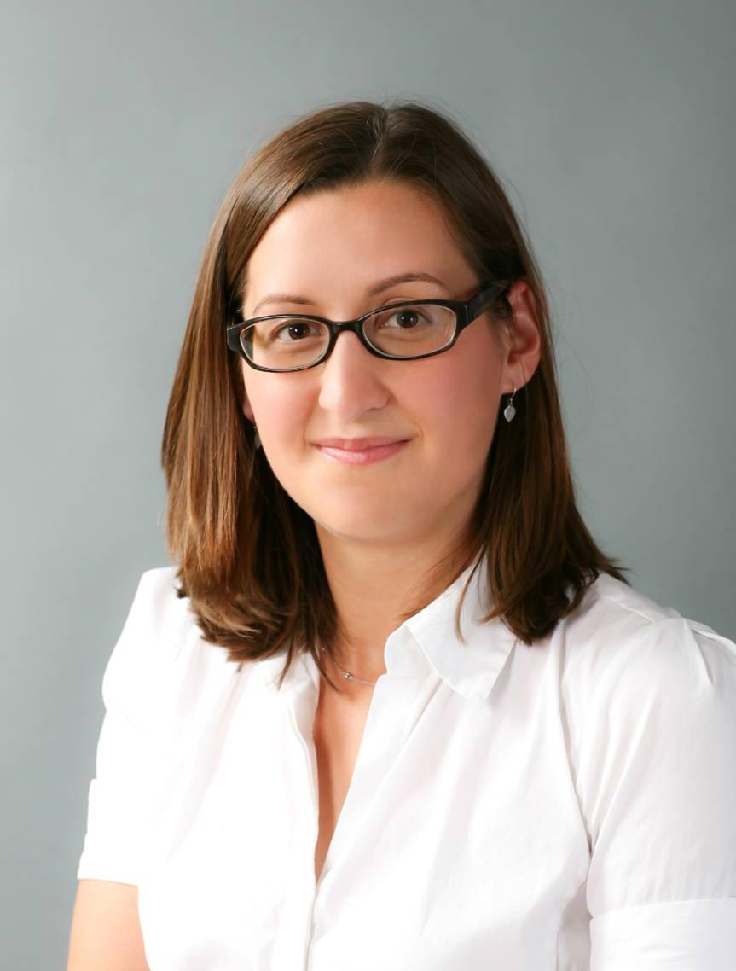
Reflection - Rev. Nancy McDonald Ladd

Slide 18
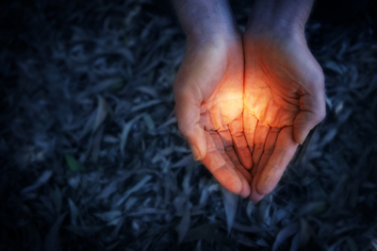

Slide 19
Questions and Discussion

Slide 20
