Slide 1
The Problem & Promise of Infinite Love
Rev. Dr. Terasa G. Cooley
John Murray Lecture – General Assembly
June 26, 2014

Slide 2
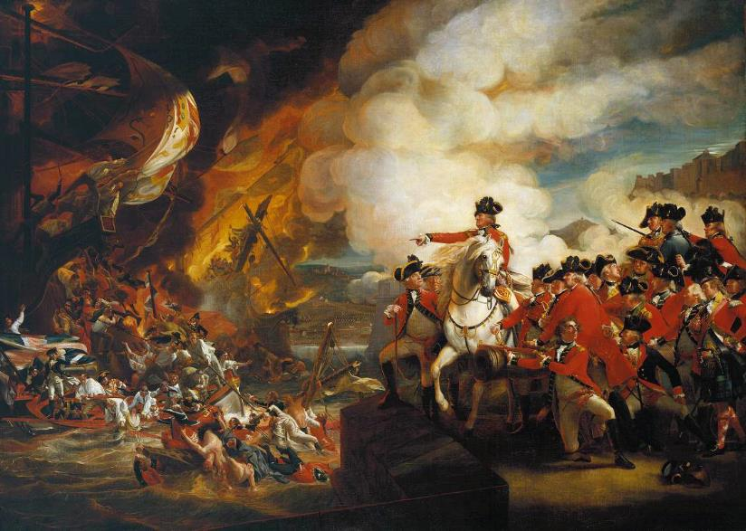
Parallels in History
Times of great foment and division

Slide 3
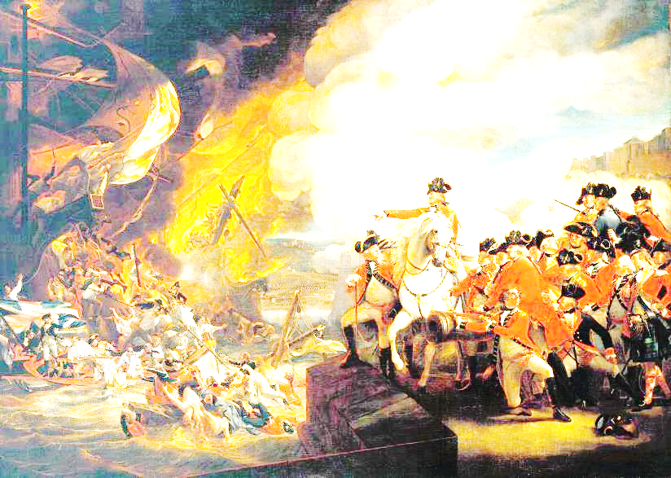
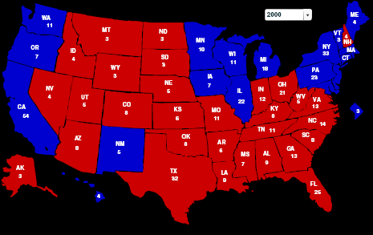
Parallels in History
Times of great foment and division

Slide 4
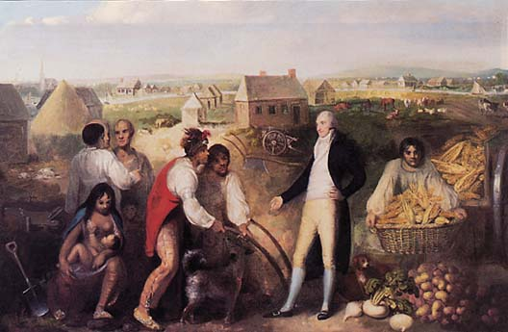
Parallels in History
Awareness of wider world

Slide 5
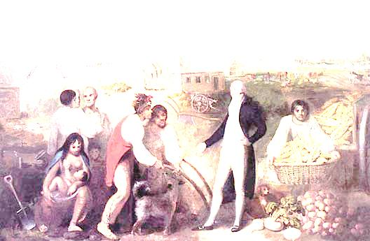
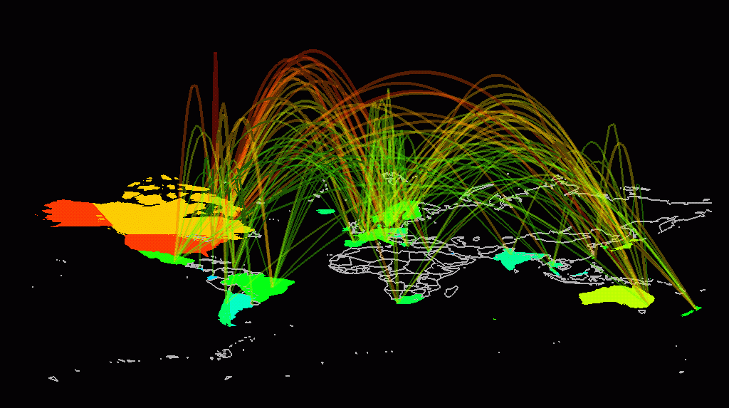
Parallels in History
Awareness of wider world

Slide 6
Parallels in History
Paradigm Changes

Slide 7
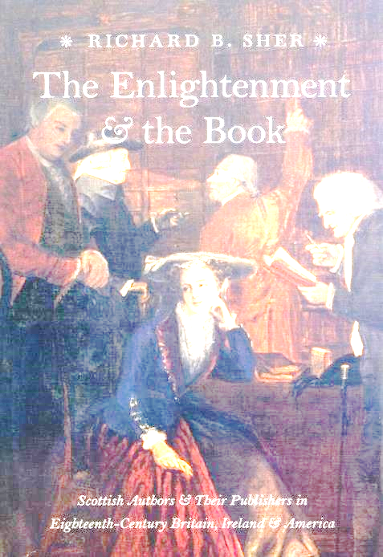
Parallels in History
Paradigm Changes

Slide 8
Core Teachings of Universalism
that whatever else God may be or not be, God is love — and that even if we reject belief in God at all, we can still believe in the power of love
that no individual or tradition possesses the whole truth, but that each grasps a piece of what is true, perhaps several such pieces
that all people are somehow sacred, whether we call this an inner divinity or simply human dignity
and that the same fate—whatever it may be—awaits us all.
Stefan Jonasson

Slide 9
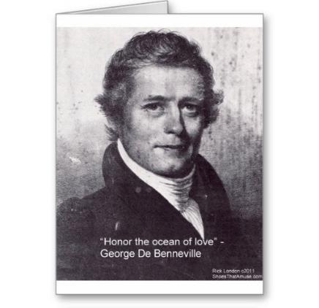
World-Wide Love
"The spirit of Love will be intensified to Godly proportions when reciprocal love exists between the entire human race and each of its individual members. That love must be based upon mutual respect for the differences in color, language, and worship, even as we appreciate and accept with gratitude the differences that tend to unite the male and female of all species. We do not find those differences obstacles to love."
George de Benneville

Slide 10
World-Wide Love
“Life in a Day” Trailer: http://youtu.be/w8S4gGI4nRo

Slide 11
World-Wide Love

Slide 12
World-Wide Love

Slide 13
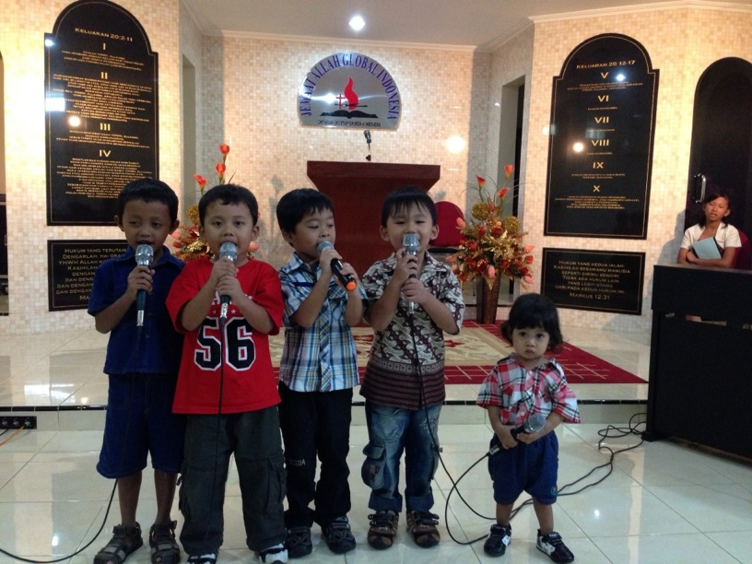
World-Wide Love

Slide 14
World-Wide Love

Slide 15
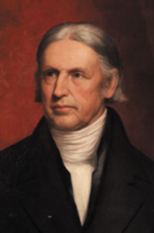
Paradigm Shift
It is the goodness of God’s will that all people shall be holy and happy
Pharrell Williams “Happy” Ringtone: http://youtu.be/utDQaejHDN4
Hosea Ballou

Slide 16
Paradigm Shift
What the Internet is Doing to Our Brains: http://youtu.be/cKaWJ72x1rI

Slide 17
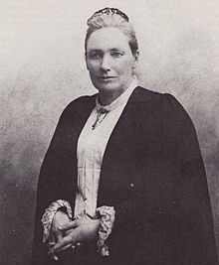
Evangelism – an answer to separation
“Let the creeds remain as historic landmarks, but let the church the Master founded move on."
Augusta Jane Chapin

Slide 18
Evangelism – an answer to separation
Apple iPhone Christmas Commercial 2013: http://youtu.be/v76f6KPSJ2w

Slide 19
Evangelism – an answer to separation

Slide 20
Evangelism – an answer to separation
Wholetime in America: http://youtu.be/YIhZocknKuM

Slide 21
Evangelism - an answer to Dislocation

Slide 22
Evangelism - an answer to Dislocation

Slide 23
Evangelism - an answer to Dislocation

Slide 24
Love Reaches Out
Love Reaches Out: http://youtu.be/OvlPa28cVfA

Slide 25
What we can do
Live the Dream
Reach Out from Within
Connect - Respond - Commit

